Slide 1

Thank you for work sent through last week.
Here are some of my favourites making it into this week’s Wall of Fame!
Check out the school website for more photographs. These are updated every week.

Slide 2
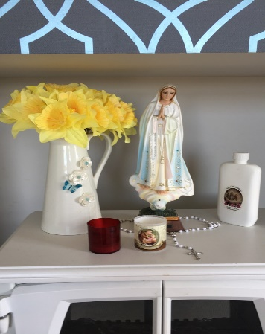
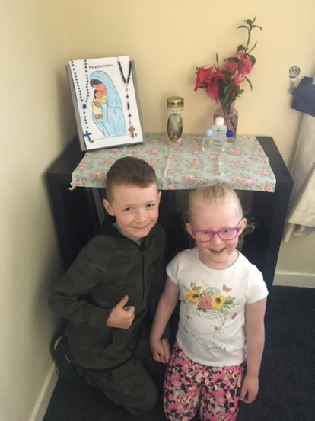
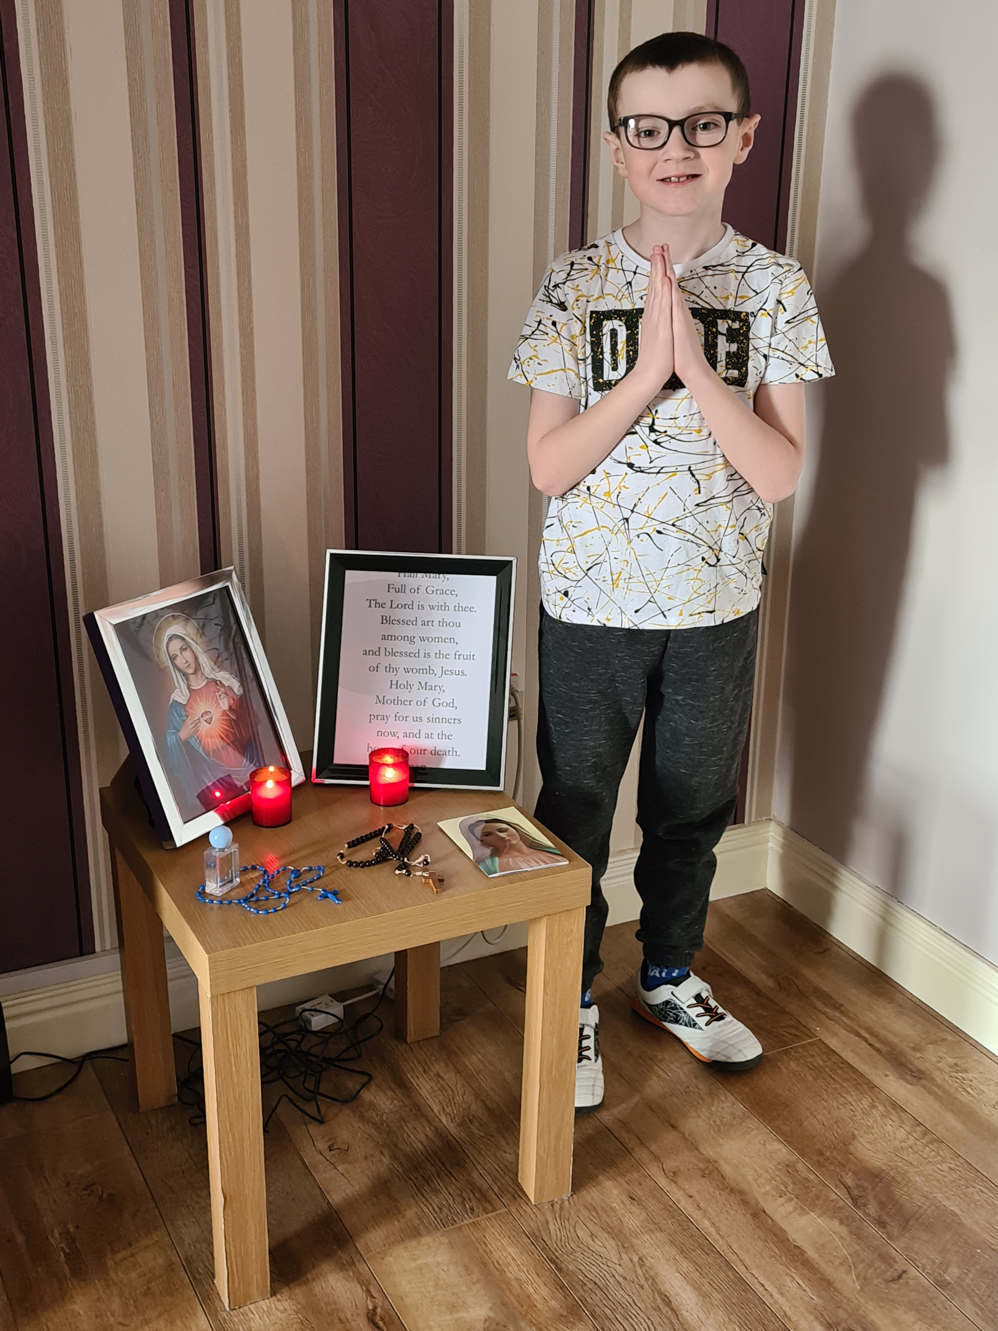
A video clip of Marnie reciting her 7 times tables at record speed!
Dean’s piece of writing about taking up running during Lockdown to stay fit and healthy.
Daniel’s story about how he is learning Spanish with his dad and how he is the master of board games in his house.

Slide 3
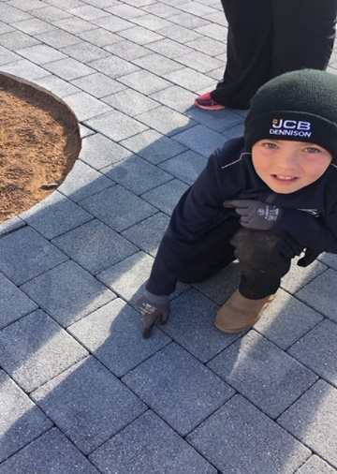
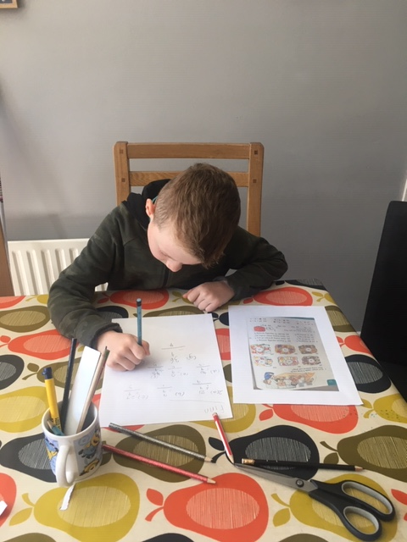
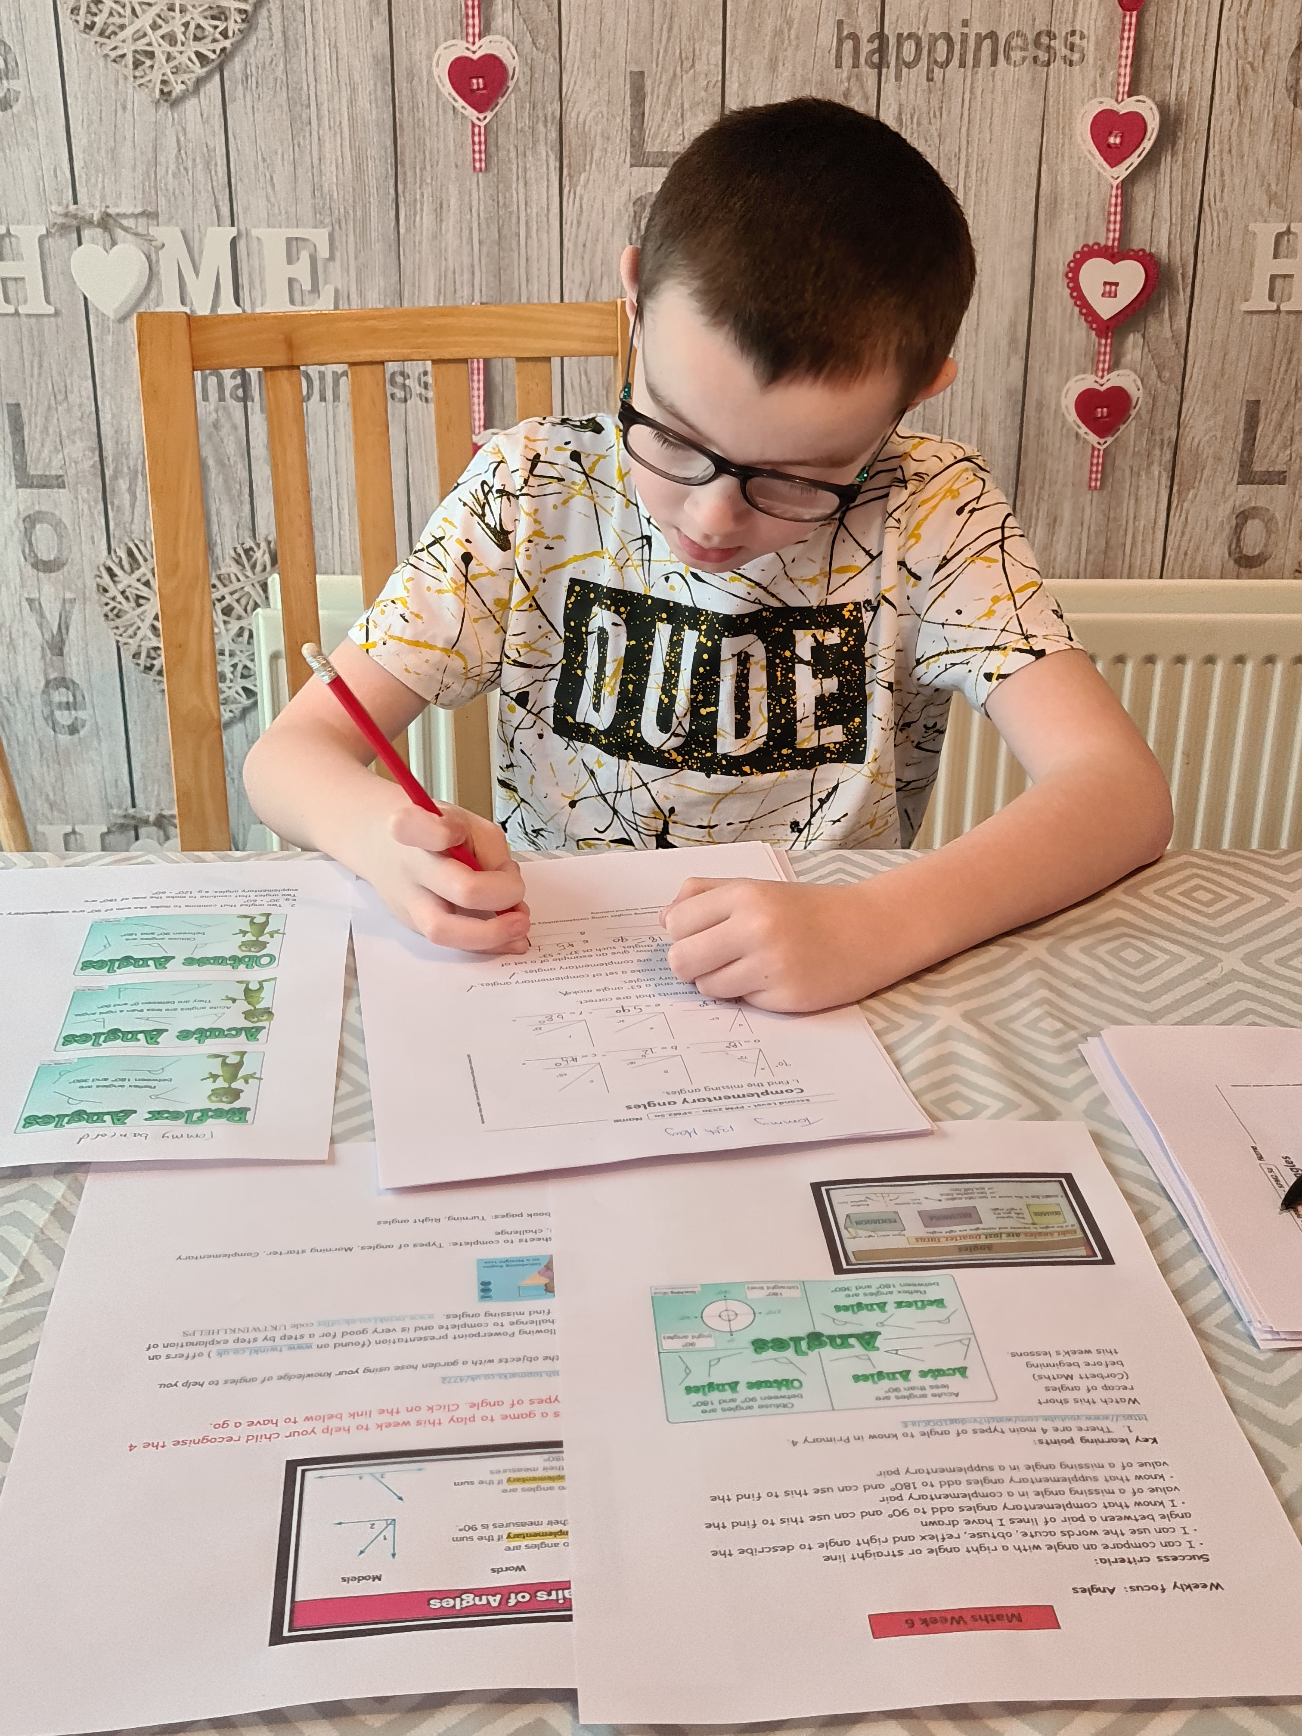
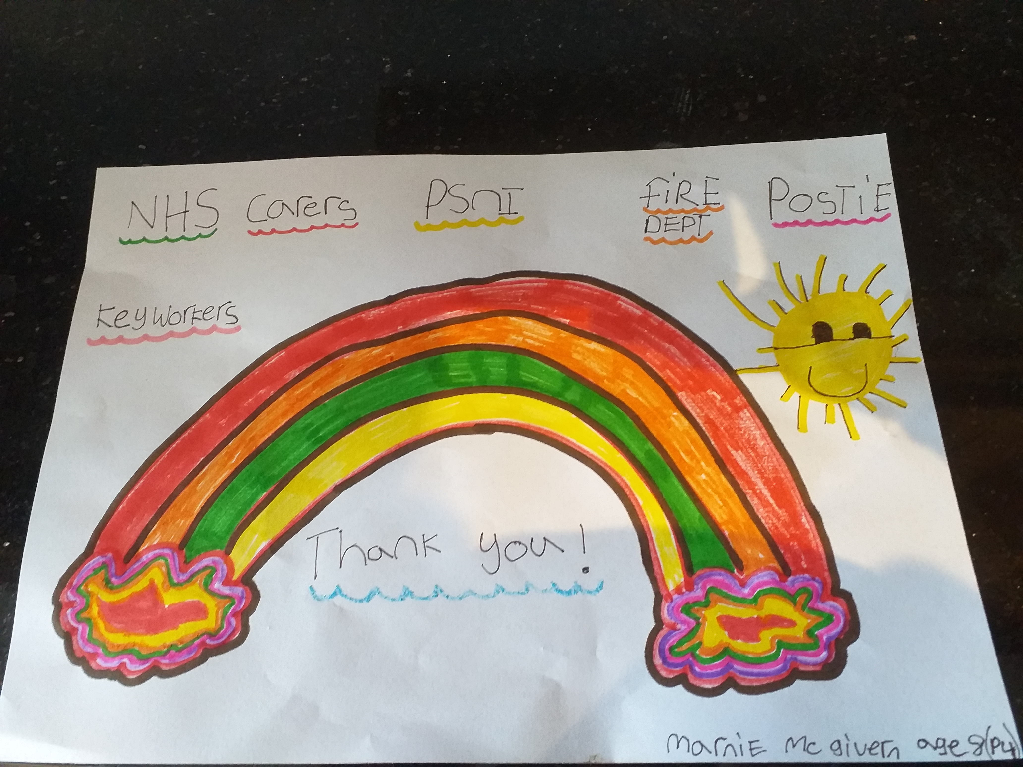
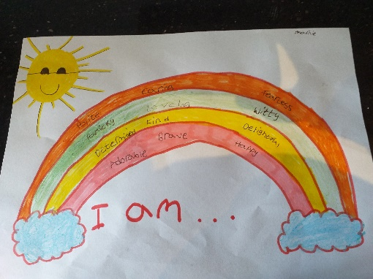
“I am Special” by Marnie

